Slide 1
Sentiment mining of the bioinformatics literature
Student Name: Teodor Stefan Pintea
Supervisor: Goran Nenadic

Slide 2
Aims and Objectives
Create a piece of software that is able to process an academic paper and split it into words, phrases and paragraphs.
Create an efficient algorithm that can accurately divide the feelings into positive or negative.
Use the algorithm described above to research the sentiment of biomedical papers.
Apply the algorithm not only on the paper as a whole, but also on smaller things such as tools used, documents mentioned, feelings about the academic findings, feelings about paper's objective/conclusion, etc.
Compare the feelings that biomedical papers expressed now vs in the past.

Slide 3
Motivation
“Well, performance issues, it’s not uncommon.” - Tony Stark
Being able to identify how professionals refer to certain scientific aspects in a paper that they publish might influence readers’ perception.
It is useful to notice if there is a difference in the way people were writing scientific papers in the past, comparing to now in order to observe the new communication trends, quantify the impact differently and understand the unspoken/unwritten opinion about a certain discovery/tool.

Slide 4
Ethical concernes
There are no ethical frameworks that need to be taken into consideration when building this project because the project does not use any personal data about a company or person.

Slide 5
Work Ethics
Properly imitate the industry environment.
Work AGILE.
Keep track of time and tasks.
Commit on a regular basis.
Have one/two back ups for the code.
Add to the documentation on the go.
Add resources.
Read papers while working on the project.
Write small ideas for the final report.
Draw the project step by step and create a map of the whole workflow.
For every aspect, create a visual representation of what is needed to be done.

Slide 6
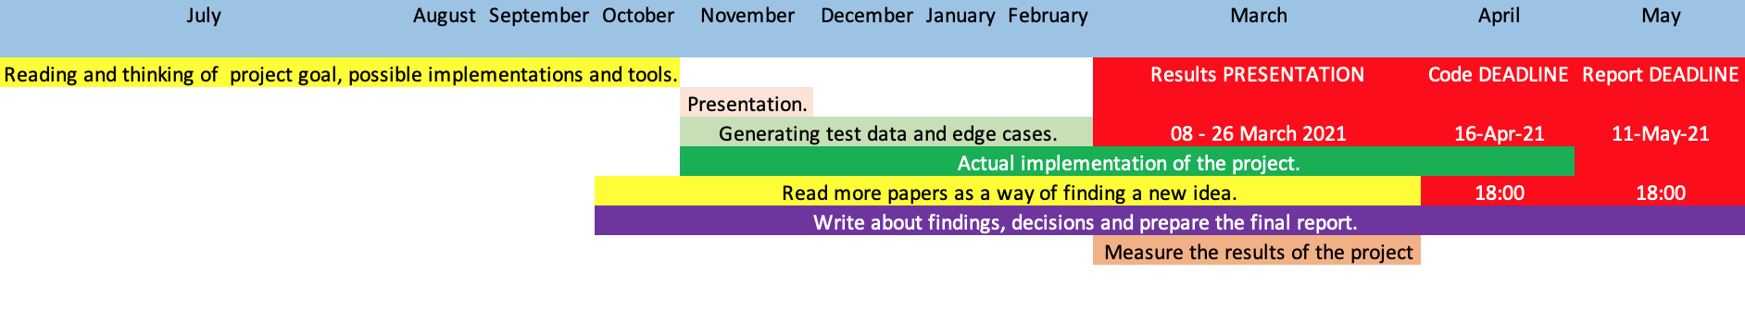
Workflow

Slide 7
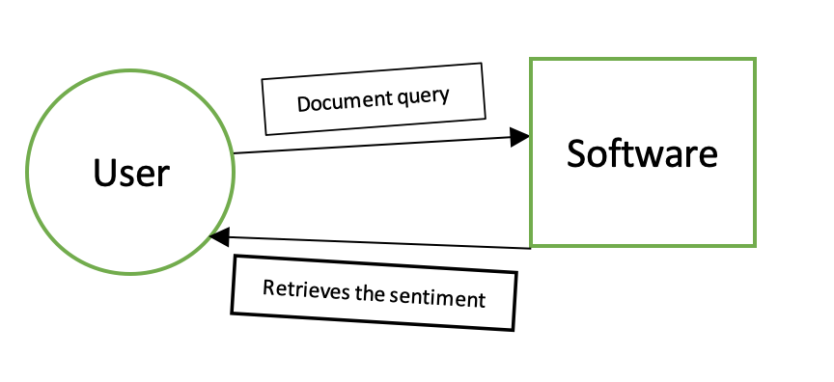
How will the user interact with the software?

Slide 8
Document query and Response
Document query
Can be asking for the overall sentiment.
Can be asking for just the sentiment of the paper.
Can be asking for just to the tools’ sentiment.
Can be asking for a specific tool..
Response
Will be the result of the overall sentiment of the paper.
Will be the result of individual tools that were user in the paper.
Will be the result calculated for a specific tool.

Slide 9
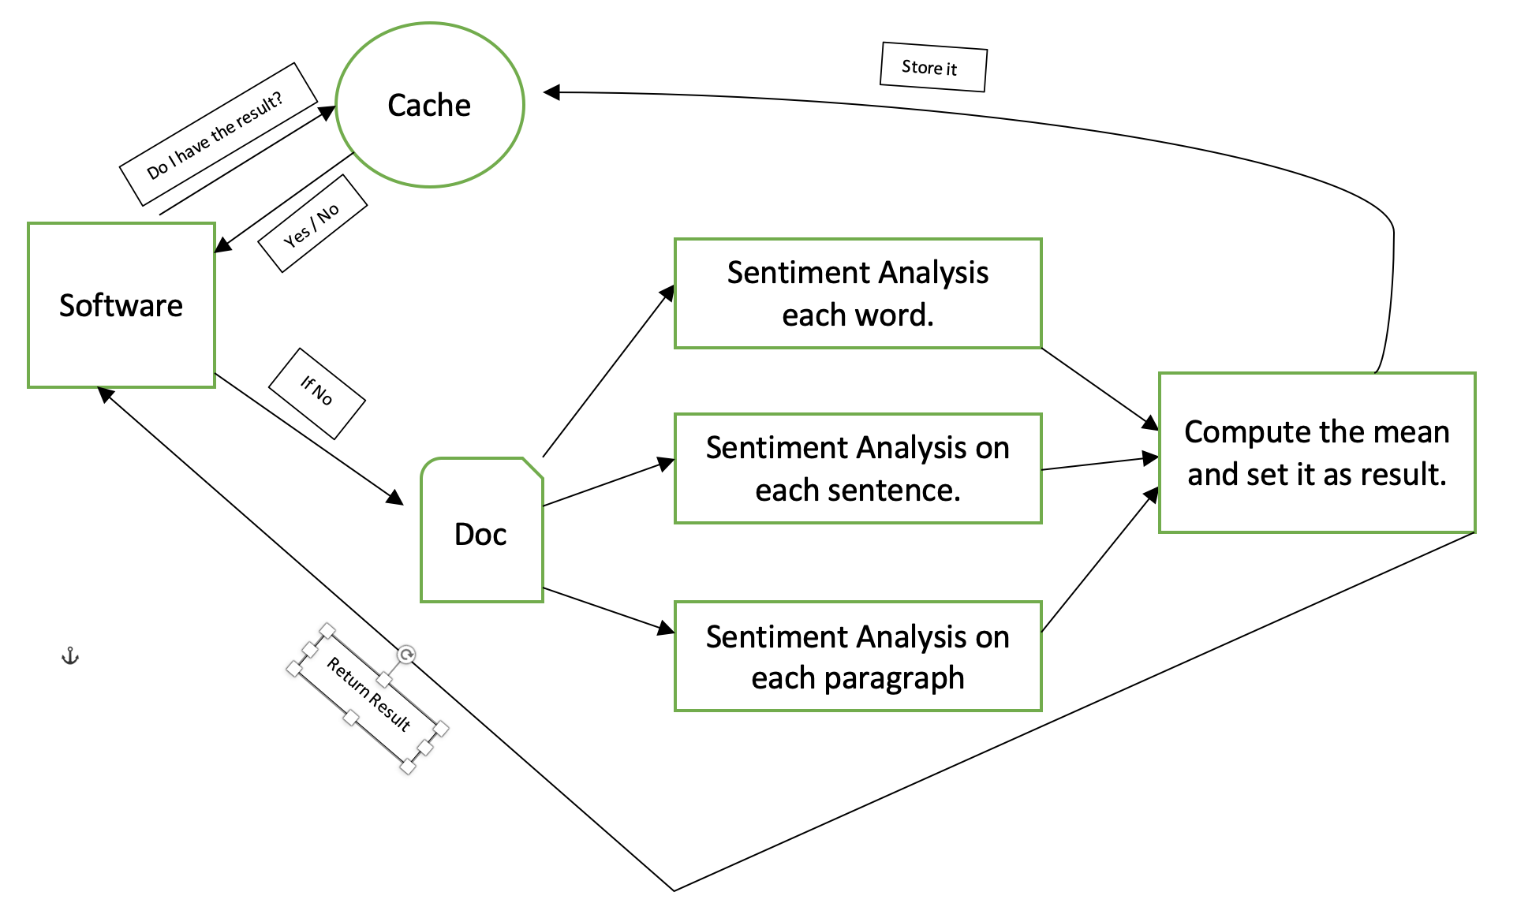
How will the software work in the background?

Slide 10
Acknowledgements
More things will happen in the program background.
Sentiment for tool will be a separate method.
The workload will be distributed.
Structure of the project will probably change as more tools will be discovered, added or got rid of.
Everything will be programmed using:
Python 3
NLTK
GitLab (both personal and university)
React (for the UI)
More tools will be added.

Slide 11
Further ideas.
Integrate the software with past project, so the sentiment for a specific tool/licence will be displayed near the software’s name.
Identify how to classify the sentiments of a proper into emotion categories (e.g. anger, love, hate, etc.)
Improve accuracy.

Slide 12
Thank you for your time!
Any questions/suggestions?

